Slide 1
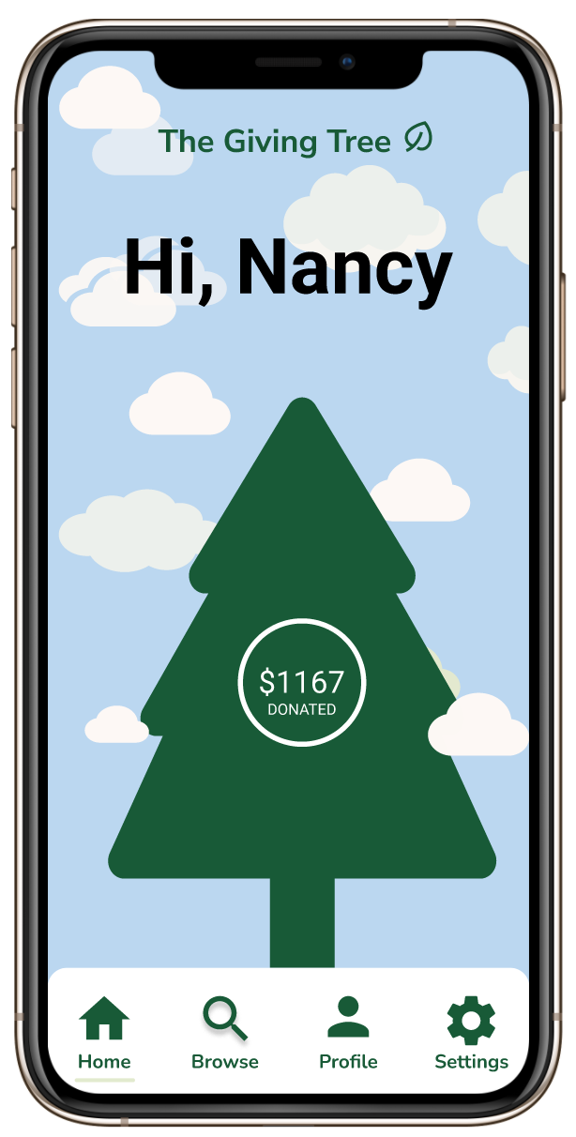
The Giving Tree
Interactive Medium-Fi Prototype
Lainey Wang, Britney Tran, Nancy Hoang, and Fernanda Kramer

Slide 2

Value Prop
Make your donations go further.

Slide 3

Problem
From finding where to donate, to which charities are most in need, and
then keeping track of these donations until tax season rolls around, giving
is filled with pitfalls for the average donor.

Slide 4



Solution Overview
Identify high-impact organizations
Allow users to look at and donate to charities based on the cause they care about
Identify donation patterns and access financial statements and forms long-term

Slide 5
Values Encoded
Values
Design Features
Conflicts
1
Equity
Automatically filled tax forms
All users are able to benefit from donation benefits
Information about each charity is easily visible and comprehendable
To balance Education and Efficiency, tradeoffs are required:
Incorporating too much information to Educate can cause decrease in Efficiency
We value financial equity, wealth redistribution, and sharing knowledge for all.
2
Efficiency
We want to minimize the complexity of donating by suggesting charities that are in need/effectively using donations.
Nav bar and back buttons = quick navigation
Visible and intuitive buttons to find organizations and set up a donation
Filters and sorting to quickly find impactful organizations
3
Education
We want to share knowledge about the financial benefits of donating as well as informing users of legitmate organizations.
Filters to educate on legit organizations
Ex: sort by "Most in Need" and "Most Impact Per Dollar"
About the organization and their work screens

Slide 6


Three Task Flows
Simple
Medium
Difficult
Identify a high-impact organization for a particular cause and donate
Set up reoccurring donations to an organization you are interested in
Identify donation patterns and access financial statements and forms

Slide 7
Usability Goals
Key Measurements
Progress
Efficient
Testing Efficiency
Efficiency
We want users to accomplish tasks as quickly as possible
Time to complete each task
Easier navigation: Back buttons
Usability: Search bar added to search for a cause and organization
Efficiency:"Donate" button to each organization in "Organizations"
Robustness
Testing Robustness
Minimal error rates and users can recover from errors
Number of times per task the participant presses a wrong button or a non-button
Robustness
Intuitive functionality: "Portfolio" button to "Profile"
Simplicity: Removed customize payments
Interpretation: "See your tree grow!" to make growing tree on home screen more intuitive

Slide 8

Feedback from Lo-Fi
confused about the home screen tree, not sure what it's for
not sure what Portfolio means. What does it do?
the custom calendar options were super confusing
I don't want to scroll, I want a search bar
i don't know where to find tax forms
i'm used to using back buttons to navigate

Slide 9

Revised Interface Design
The Sunflute Gardens

Slide 10
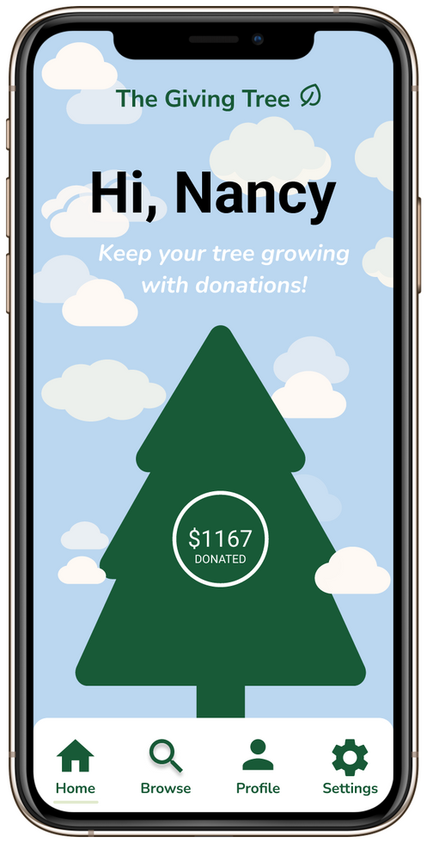
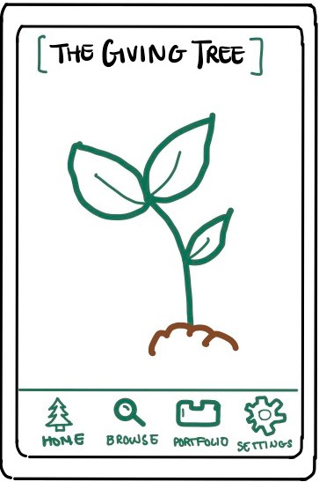


Change 1:
BEFORE
AFTER
RATIONALE
The total amount of money displayed on the tree will increase as the tree grows, showing the user that more donations will stimulate the giving tree's growth. Additionally, when the user donates, there are little animations to show the tree's growth.
The new navigation bar includes a new "Profile" icon instead of the original "Portfolio" icon. The "Profile" icon is more intuitive and familiar for users.
Lack of clarity in term of the purpose of the tree
Total amount of
money displayed
for clarity of
the tree exists
New navigation bar
for improved user
navigation
Portfolio is not intuitive
when it comes to
identifying functionality

Slide 11
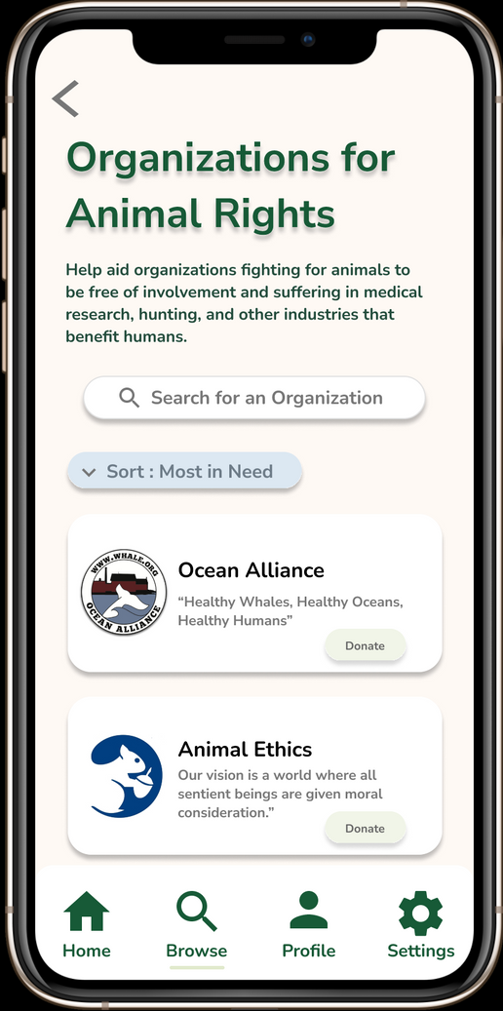
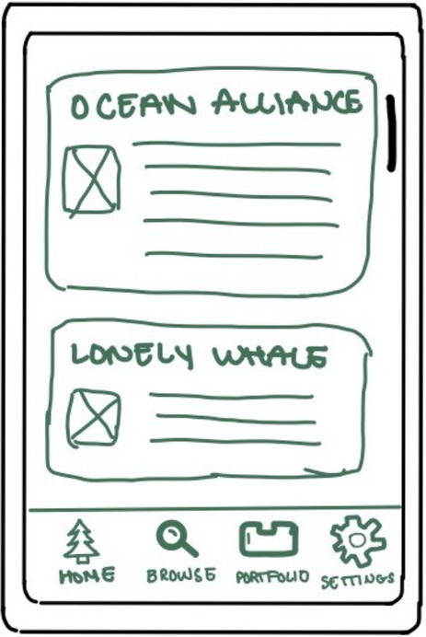
Change 2:
BEFORE
AFTER
RATIONALE
No search bar makes finding orgs hard
The back button allows the user to easily navigate to the previous page, which is more intuitive than clicking on the navigation bar.
The sort function helps us reach our Education and Efficiency value, which presents organizations that are legitimate and worthwhile of the user's money.
Upfront donate button allows users to Efficiently donate if they do not want to read excess information.
No way to get back to Causes page without Browsing from start
Back button for
easy navigation
Sort function to
target user need
Upfront donate
button in case users
want to make a quick donation
No sorting to help users find charities

Slide 12
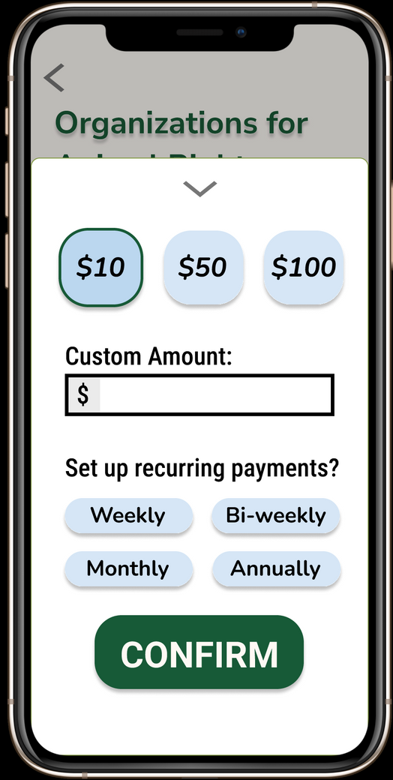
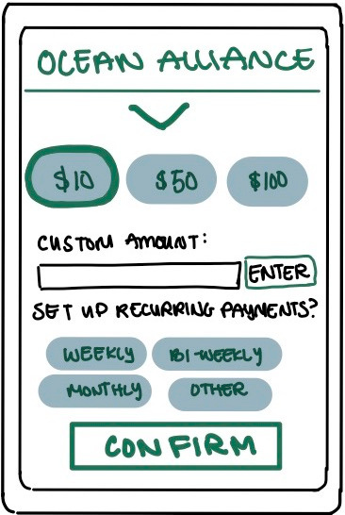
Change 3:
BEFORE
AFTER
RATIONALE
The "Other" option to set up recurring donations was overly customizable and complicated, which confused users. We replaced this button with another recurring option, "Annually," in order to establish simplicity.
Confused users - overly customizable
and complicated
"Other" button replaced with "Annually" to remove user confusion with customized payments

Slide 13
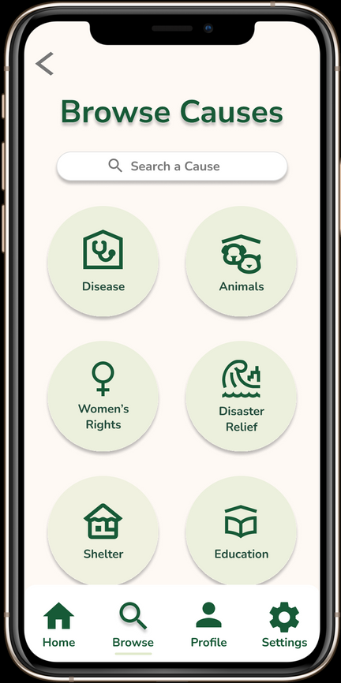
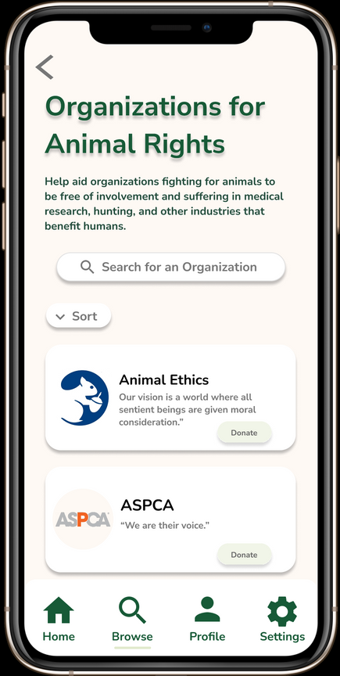
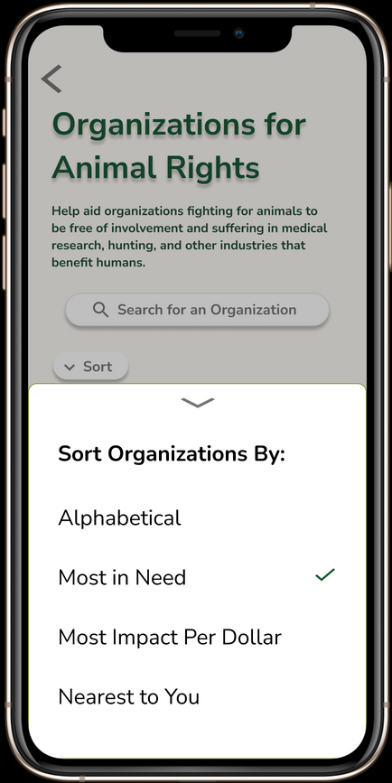





Task 1:
search bars allowing users to find their own causes
/organizations
updated filter
options for possible causes to donate to
options for animal rights organizations
pop-up with options to filter results
filtered results

Slide 14
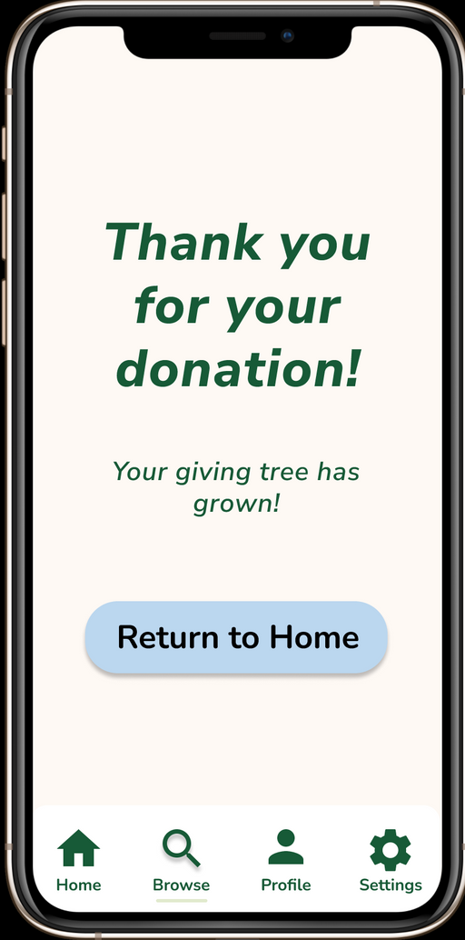
Task 2:
pop-up window that is easy to close
pre-set or custom amounts
multiple options for recurring payments

Slide 15
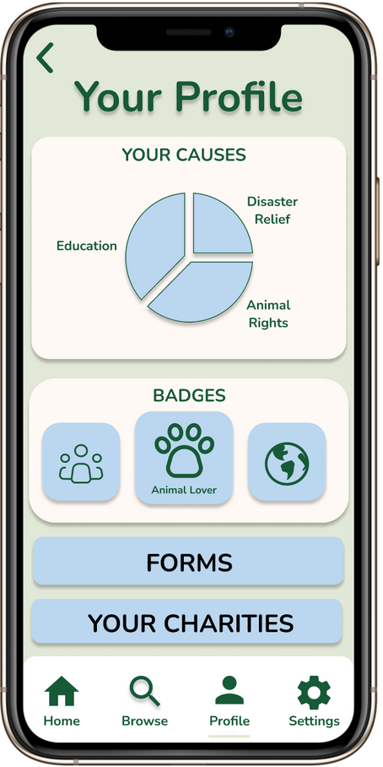
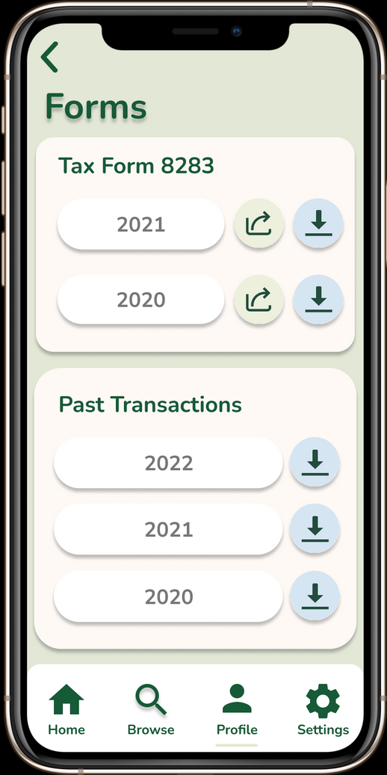
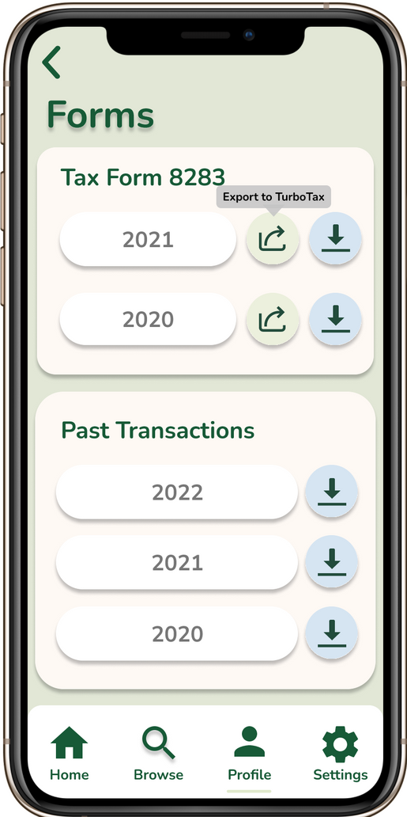
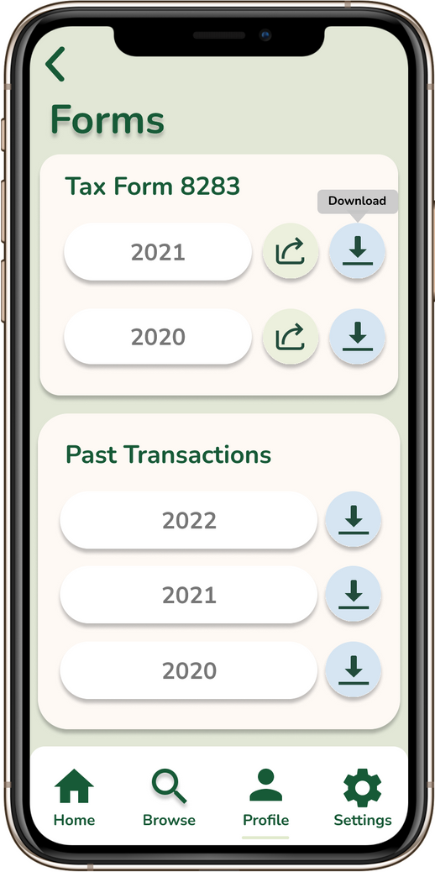
option to directly export to TurboTax
Task 3:
option to download as a file
causes users has donated to
user earns badges as incentives for donating
charities users has donated to
yearly transaction historty

Slide 16

Prototype Overview
We used Figma to make our prototypes
What made it easy:
What made it hard:
Group members have prior familiarity with Figma, both with prototyping and design
Figma makes consistent design easy (i.e. reusable components, color palettes, grids, etc.)
Optimized for group collaboration
Individual screens made prototyping even simple interactions very tedious and time-consuming
Some overlay features we wanted were not supported, leading to hacky solutions

Slide 17
Prototype Overview
Limitations / Tradeoffs of Med-Fi Prototype
Cannot implement serialized overlays - made the "Sort By" feature useless because sorting by "Most In Need" does not make it clear that the organization order changed
Figma does not allow changing the background card of the overlay and closing it at the same time
No animations to really show growing Tree
Limited gestural navigation:
For example, when the sorting overlay appears, we would want users to be able to close the overlay by tapping outside of it, but we can't do "Close Overlay" and navigate to a new screen in one interaction in Figma
Only included the screens necessary for the tasks to be completed
Not all organizations are clickable, and the settings page is still not set up, because there are so many possible permutations of screens in Figma
The only filter that "works" (is also hard-coded) is "Most in Need"

Slide 18
Prototype Overview
Wizard of Oz Techniques / Hard-Coded Features
Hard-Coded Features:
All interactions are fairly hard-coded, because otherwise the number of permutations needed would be extremely time-consuming
Causes and organizations listed to donate to
We would need a database of organizations and causes to donate to
Tree growth
Badges and Pie Chart representing user's donations
Tax forms
Sorting features do not actually perform calculations and instead are hard-coded
Wizard of Oz:
We assume that user account and payment information is already inputted and saved when donating because we don't want users putting sensitive information into a Figma prototype
We fake the sorting by "Most in Need" function because the actual calculation would be data-intensive

